Slide 1

Intro to Maven

Slide 2
Agenda
Why Maven?
The Maven Way
Maven Basics
Multi-Module Projects
Web Projects
Integration Testing
Clean/Advanced Maven

Slide 3
What Is Maven?
Build tool (focused on JVM)
Convention over configuration
Structured project model
Build code reuse

Slide 4

Why Maven?

Slide 5
Regular Structure
Approachable
Machine-readable
Codifies good practice
Supports collective ownership

Slide 6
Good Practices
Separate code, tests, resources
Platform independence
Declarative dependency management
Share resources via dependencies
Predictable directory structure
Test built artifacts

Slide 7
Why Not Maven?
General automation
Legacy code with intricate build incantations
Might be able to bridge with AntRun or custom plugins

Slide 8
The Maven Way
Don't fight Maven. You'll lose.
Maven is a box that turns source code into build artifacts
First, try to see how your problem fits into Maven's worldview
Next, you might want to write a plugin or use AntRun
If you're still struggling, you may want to consider another tool

Slide 9
Maven Basics

Slide 10
Creating a New Project
<?xml version="1.0" encoding="UTF-8"?>
<project xmlns="http://maven.apache.org/POM/4.0.0"
xmlns:xsi="http://www.w3.org/2001/XMLSchema-instance"
xsi:schemaLocation="http://maven.apache.org/POM/4.0.0
http://maven.apache.org/xsd/maven-4.0.0.xsd">
<modelVersion>4.0.0</modelVersion>
<groupId>com.example.maventraining</groupId>
<artifactId>simple</artifactId>
<version>1.0-SNAPSHOT</version>
</project>
mvn archetype:generate -DgroupId=com.mycompany.app -DartifactId=my-app -DarchetypeArtifactId=maven-archetype-quickstart -DarchetypeVersion=1.5 -DinteractiveMode=false

Slide 11
Running Maven
mvn <phase or goal> [<phase or goal>...]

Slide 12
Maven Lifecycles
Clean - handles project cleaning
Default – handles project deployment
Site – handles the creation of the project’s website

Slide 13
Default Lifecycle
Validate – Checks that the project structure and configuration are correct.
Compile – Compiles the project’s source code.
Test – Runs unit tests using a suitable testing framework.
Package – Packages the compiled code into its distributable format (e.g., JAR, WAR).
Integration-test – Deploys the package to an environment and runs integration tests.
Verify – Runs checks to ensure the package meets quality standards and criteria.
Install – Installs the package into the local Maven repository for use in other projects.
Deploy – Copies the final package to a remote repository for sharing with others.

Slide 14

Dependency Management
<dependencies>
<dependency>
<groupId>junit</groupId>
<artifactId>junit</artifactId>
<version>4.11</version>
<scope>test</scope>
</dependency>
</dependencies>
Coordinates: groupId, artifactId, version, and optional scope

Slide 15
Dependency Scopes
compile (default) – Available in all build phases and included in the final artifact.
provided – Needed for compilation but expected to be provided by the runtime environment (e.g., a servlet container (Tomcat, Jetty etc.).
runtime – Not required for compilation but needed at runtime execution.
test – Available only for test compilation and execution, not in the final artifact.
system – Similar to provided, but you must explicitly provide the JAR from the local file system.
import – Used only in <dependencyManagement> to import dependencies from another POM.

Slide 16
Snapshot Versions
Good for intra-project dependencies during development
Will check for updates each time you build
Will break your build eventually outside a single source tree
x.x-SNAPSHOT

Slide 17
Release versions
Generated by the release plugin
Assumed immutable (cached aggressively)

Slide 18
Directory Layout
src/main/java | Application/Library sources
src/main/resources | Application/Library resources
src/main/webapp | Web application sources
src/test/java | Test sources
src/test/resources | Test resources
target | Build output

Slide 19
Super POM
The POM from which all other POMs inherit
Look here for defaults
http://maven.apache.org/ref/3.0.4/maven-model-builder/super-pom.html

Slide 20
Exercise
Build a simple library that outputs "Hello, World!". Write a HelloWorld class that outputs a String and a test that invokes it. Build and test your project with Maven.

Slide 21
More Basics
Plugins
Packaging

Slide 22
Plugins
Maven's main unit of modularity
How most of Maven's functionality is implemented and configured

Slide 23
Plugin Configuration
<build>
<plugins>
<plugin>
<artifactId>maven-compiler-plugin</artifactId>
<version>3.1</version>
<configuration>
<source>21</source>
<target>21</target>
</configuration>
</plugin>
</plugins>
</build>

Slide 24
Built-In Plugins
maven-compiler-plugin
maven-surefire-plugin
maven-dependency-plugin
maven-release-plugin

Slide 25
Common Plugins
AntRun
Cargo
Jasmine
Exec
PMD
Cobertura
Findbugs

Slide 26
Packaging
Defines the artifact type
Binds goals to phases
Core values: pom, jar, maven-plugin, ejb, war, ear, rar, par
Default is jar

Slide 27
Packaging Binds Goals to Phases
Phase | Goal
process-resources | resources:resources
compile | compiler:compile
process-test-resources | resources:testResources
test-compile | compiler:testCompile
test | surefire:test
package | jar:jar
install | install:install
deploy | deploy:deploy

Slide 28
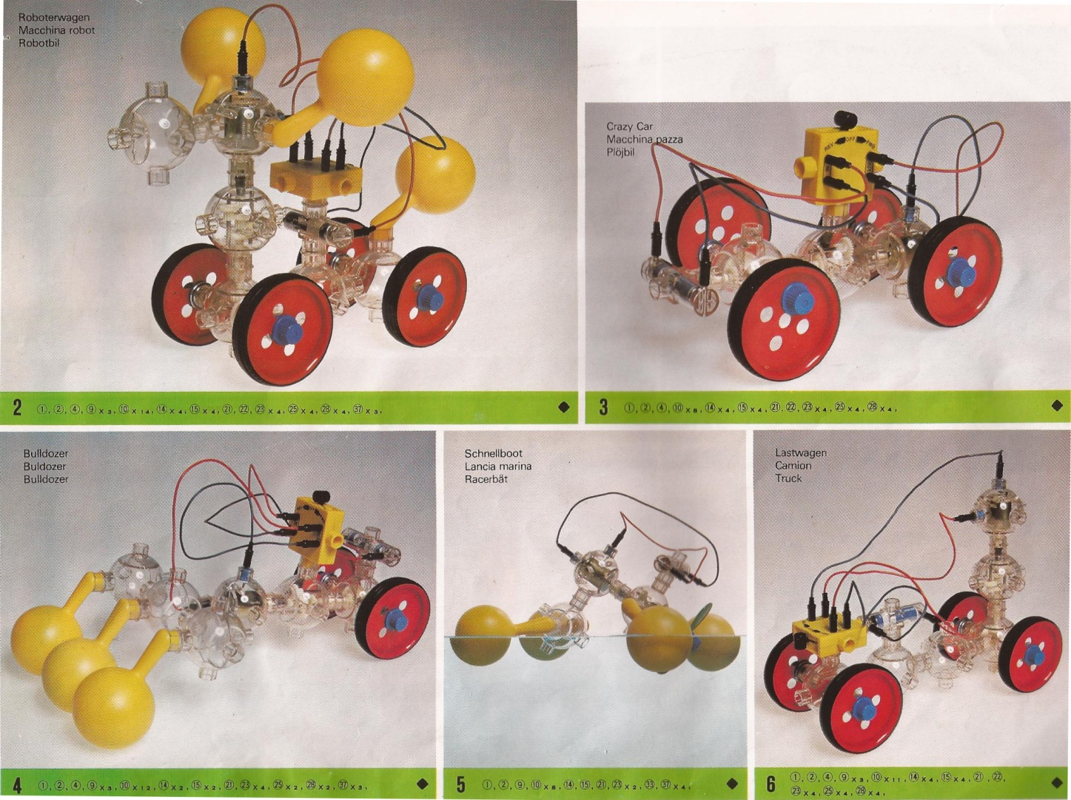
Multi-Module Maven
Why?
How?
Dependence vs. Inheritance
Naming

Slide 29
Why Multiple Modules?
Group related functionality
Isolate unrelated functionality
Organize dependencies
Unit for sharing code
Unit of packaging

Slide 30
Multi-Modules: How
Top-level pom packaging with modules
Optional parent in sub-modules

Slide 31
Modules
<modules>
<module>hello-util</module>
<module>hello-service</module>
</modules>

Slide 32
Parent
<parent>
<groupId>com.example.maventraining</groupId>
<artifactId>hello</artifactId>
<version>1.0-SNAPSHOT</version>
</parent>

Slide 33
Dependence vs. Inheritance
Use dependencies to share code, resources
Use inheritance to aggregate common settings

Slide 34
Naming
"There are only two hard things in Computer Science: naming, cache invalidation, and off-by-one errors." - almost Phil Karlton
All modules are top-level, referenced by groupId-artifactId
http://maven.apache.org/guides/mini/guide-naming-conventions.html

Slide 35
Web Modules
war packaging
Static resources in src/main/webapp
web.xml in src/main/webapp/WEB-INF

Slide 36
Q&A

